Slide 1
CS274 Computer Architecture and Organization
Professor Ann Marie V. Schilling

Slide 2
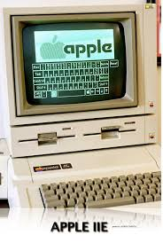
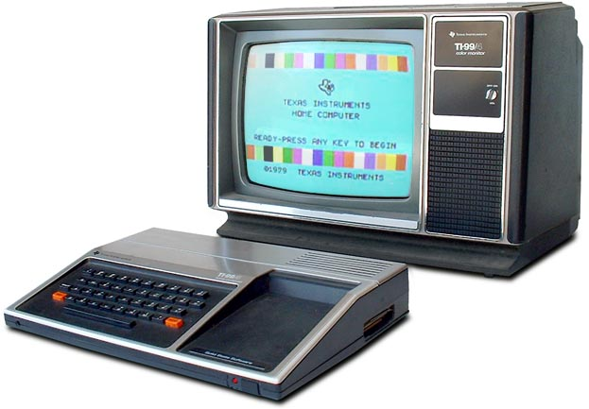
Your Professor
Wrote first program on a TI99/4a hooked up to the family’s TV-set in 1981 ish. Moved on to an Apple][e in HS

Slide 3
Your Professor
BS in Computing Sciences w/ Math, Chemistry minors from University of Scranton, Scranton PA
MS in Computing Sciences from Drexel University, Philadelphia PA
Professional Software Engineering experience in Aerospace, Finance, Banking
Professor at Ursinus 10+ years, Collegeville resident 20+ years

Slide 4
About the Class
This class examines what happens below the Application Layer of computer programs.
We answer the question:
“How do we get the processor to execute the commands we issue in a high level language”

Slide 5
Class Organization
This class is divided into four segments which together answer the essential question:
“In what manner do we harness electricity in order to perform computations.”

Slide 6
Class Organization
To answer this question, we need to know the following:
How to represent values
How to combine values to perform arithmetic and logical values
What instructions can we give electrical circuits
How do we combine electrical circuits and instructions to create a processor

Slide 7
How Computers Represent Values
We start with number systems such as binary, hexadecimal, and octal whole, positive (aka unsigned) values
We then move on to signed (pos or neg) representations of whole numbers
Lastly, we cover floating point values, also known as values with a fractional part.

Slide 8
Combining Values to Perform Instructions
Now that we know how to represent values? How do we combine them?
Logic Tables
K-map reductions
Logic gates and State Components

Slide 9
What Instructions to Use?
A processor circuit can be programmed using its Instruction Set.
Instruction sets are patterns of 1’s and 0’s which cause the processor circuit to perform operations
Luckily, the instruction set is also represented by a more human readable language called Assembly

Slide 10
What Instructions to Use?
We will be using MIPS Assembly to program a simulated chip
This language is quite different from most languages current students have seen as it is an imperative language instead of the functional and/or object oriented

Slide 11
Creating Processor from Circuits and Instructions
The processor is composed of both state and combinational circuits
The instruction set encodes behavior for the processor.

